Slide 1

NAME
ICCV 2021 Workshop on
Map-Based Localization for Autonomous Driving
Yuchen Yang, Jiafei Xu, Xudong Zhang*, Shuang Gao, Kun Jiang, Jijunnan Li, Yandong Guo
OPPO Research Institute
* indicates corresponding author. Contact: zhangxudong@oppo.com
All authors are with OPPO Research Institute, Shanghai, China

Slide 2
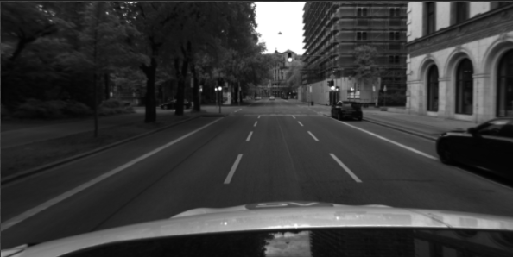

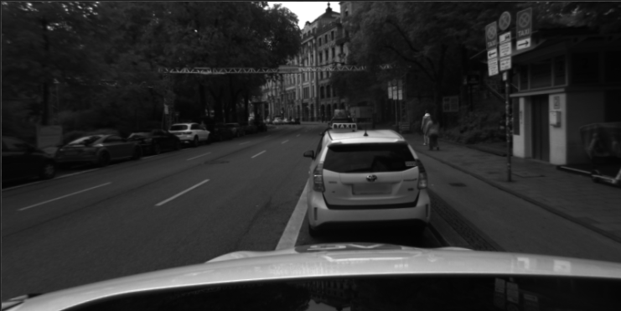
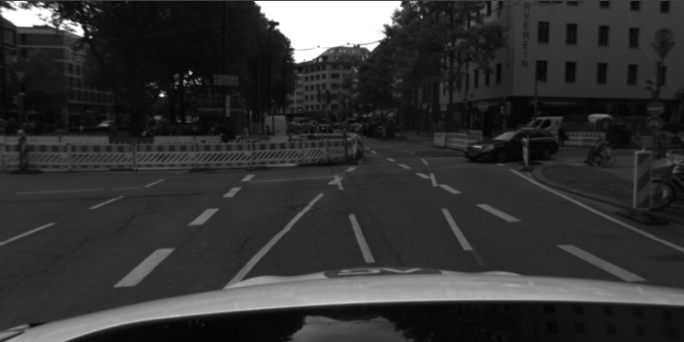
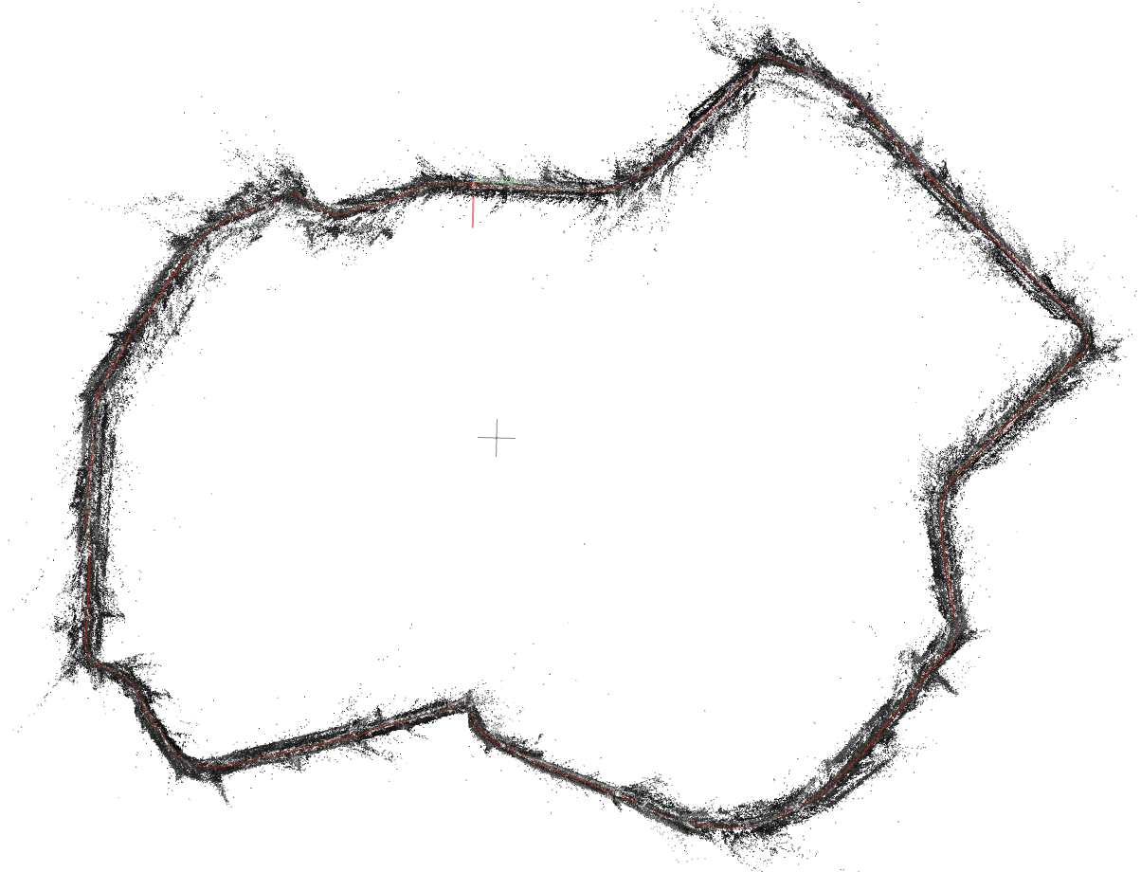
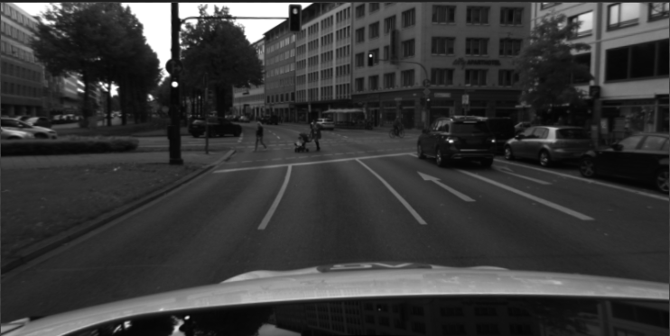
Overall pipeline
RLOCS^{[1]}
Sequential
localizer
SLAM
Localization
Global feature extraction
Image retrieval
Image retrieval filter
Relative camera pose
Query image
Local feature extraction
Feature matching &
Semantic label check
PNP RANSAC
Camera pose
Semantic
Mapping
Global feature extraction
Database extension
Local feature extraction
Re-localize failed cases
Loose coupling
Database images
Semantic segmentation
SfM
reconstruction
Final pose
[1] Zhou Y, Fan H, Gao S, et al. Retrieval and Localization with Observation Constraints[J]. arXiv preprint arXiv:2108.08516, 2021.

Slide 3

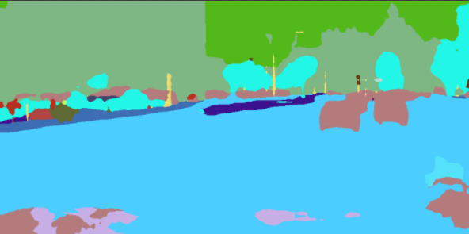

RLOCS-Mapping
Input②
Camera Intrinsic &
Image Extrinsic
Semantic point cloud
NN
matching
Input①
Colmap SfM
reconstruction
Superpoint^{[2]}
Geometric Constraint
Feature matching
Database images
NetVLAD^{[3]}
Image pairs
BiSeNet^{[4]}
(pre-trained on cityscape)
[2] DeTone D, Malisiewicz T, Rabinovich A. Superpoint: Self-supervised interest point detection and description[C]//Proceedings of the IEEE conference on computer vision and pattern recognition workshops. 2018: 224-236.
[3] Arandjelovic R, Gronat P, Torii A, et al. NetVLAD: CNN architecture for weakly supervised place recognition[C]//Proceedings of the IEEE conference on computer vision and pattern recognition. 2016: 5297-5307.
[4] Yu C, Wang J, Peng C, et al. Bisenet: Bilateral segmentation network for real-time semantic segmentation[C]//Proceedings of the European conference on computer vision (ECCV). 2018: 325-341.

Slide 4
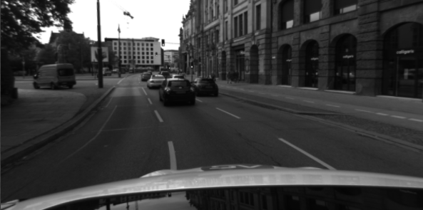
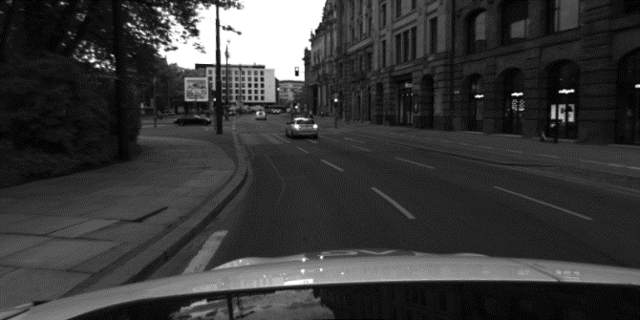
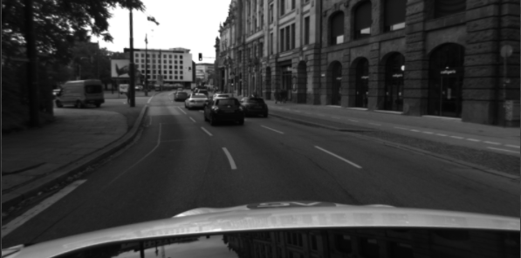
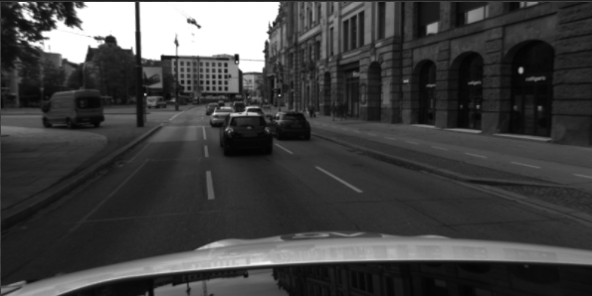
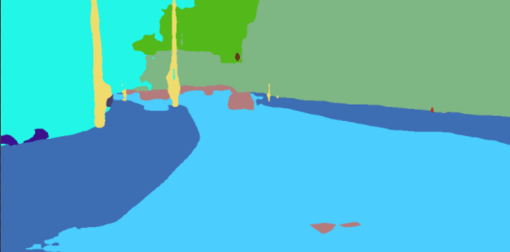
RLOCS-Localization
Query image
HOW^{[5]} image retrieval
Similar database images
Superpoint
NN Feature matching
Semantic label check
PNP RANSAC
DBSCAN
Merge matches
PNP RANSAC
Final pose
BiSeNet
[5] Tolias G, Jenicek T, Chum O. Learning and aggregating deep local descriptors for instance-level recognition[C]//European Conference on Computer Vision. Springer, Cham, 2020: 460-477.

Slide 5
Sequential localizer
Candidates
Image retrieval filter
Last frame results
Predict pose by SLAM
Image retrieval
Current & last
R-t
Predict Pose
filtering
Retrieval results
Use slam predicted pose to help filter wrong retrieval results

Slide 6
Sequential localizer
Database extension
One frame localization
Camera pose
distance < TH
Mapping
2D-3D Matches
Compare distance
distance > TH
Re-localize
Monte Carlo sampling^{[6]}
50% matches
PNP RANSAC
Sub-pose
Camera pose
Use well localized cameras to help localizing other cameras
[6] I. M. Sobol, A primer for the Monte Carlo method. CRC press, 1994.

Slide 7
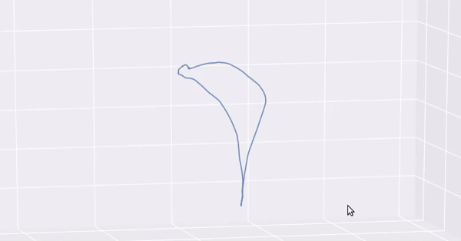
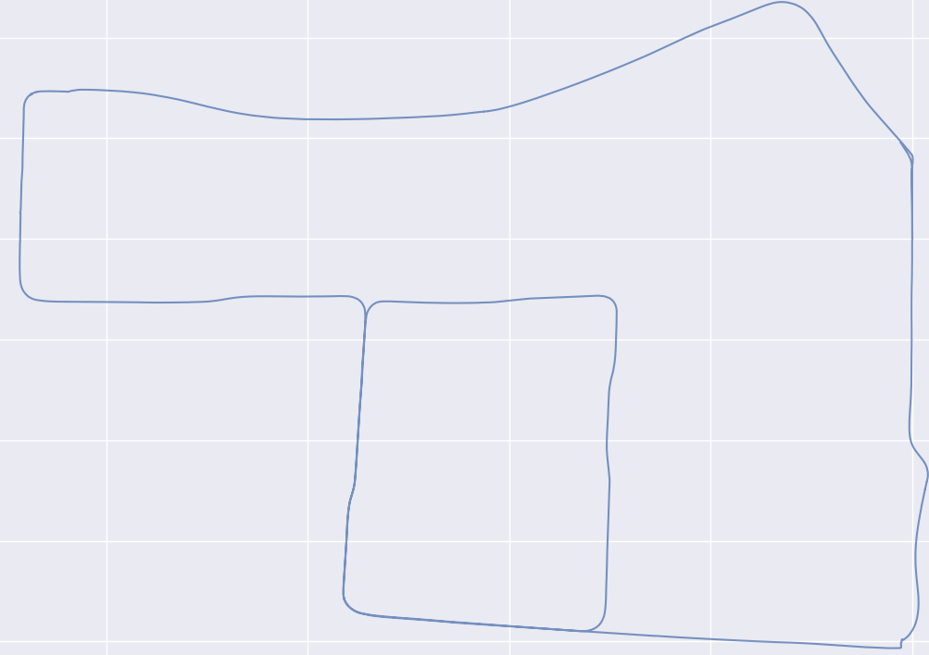
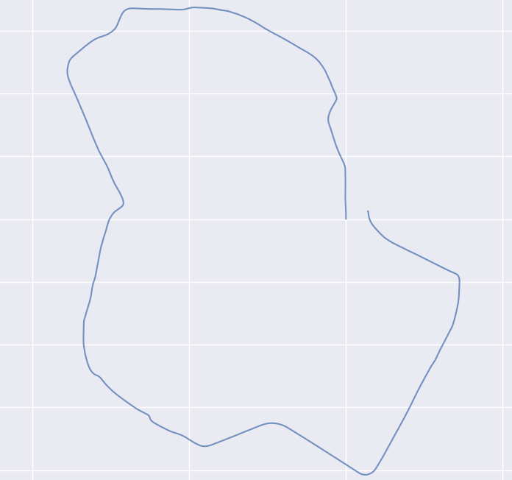
Sequential localizer
Results of ORB-SLAM2^{[7]}
SLAM & Loose coupling
Database extension results
Localization failed
frame
Closest successful frame
Quaternion & translation
Slam tracking
Final pose
Use slam getting positional relationship to help re-localize failed cases
[7] Raúl Mur-Artal and Juan D. Tardós. ORB-SLAM2: an Open-Source SLAM System for Monocular, Stereo and RGB-D Cameras. IEEE Transactions on Robotics, vol. 33, no. 5, pp. 1255-1262, 2017.

Slide 8
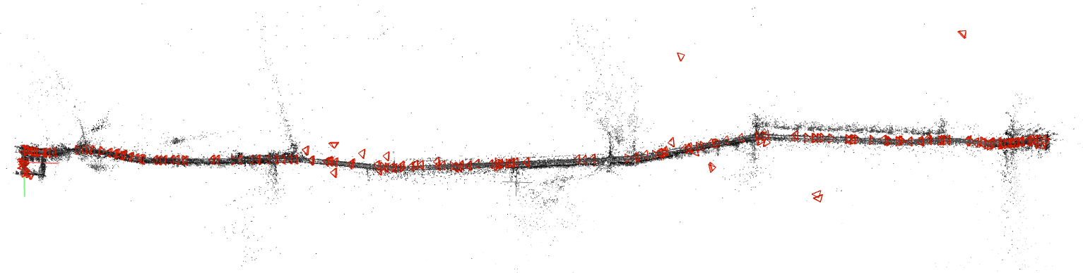
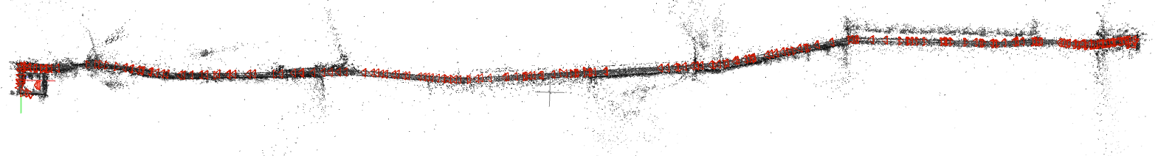
Results
Countryside – RLOCS
After adding sequential localizer

Slide 9
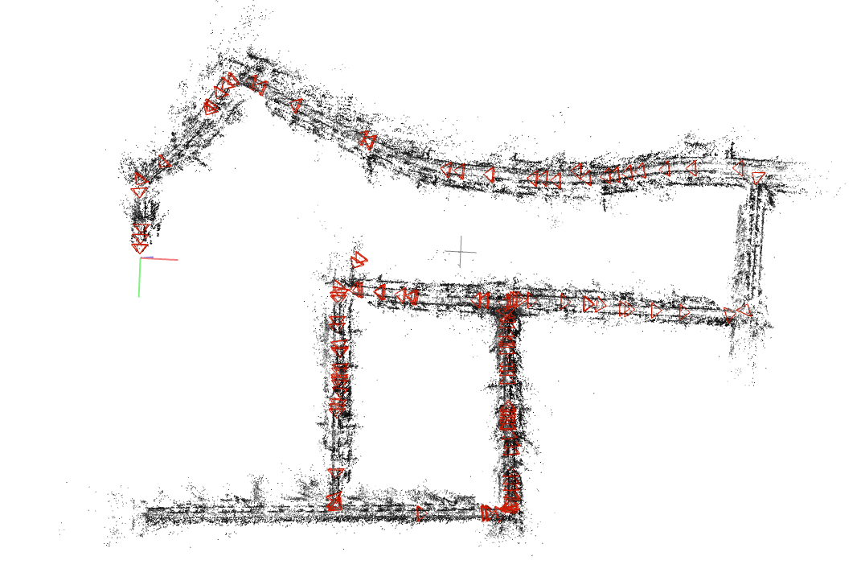
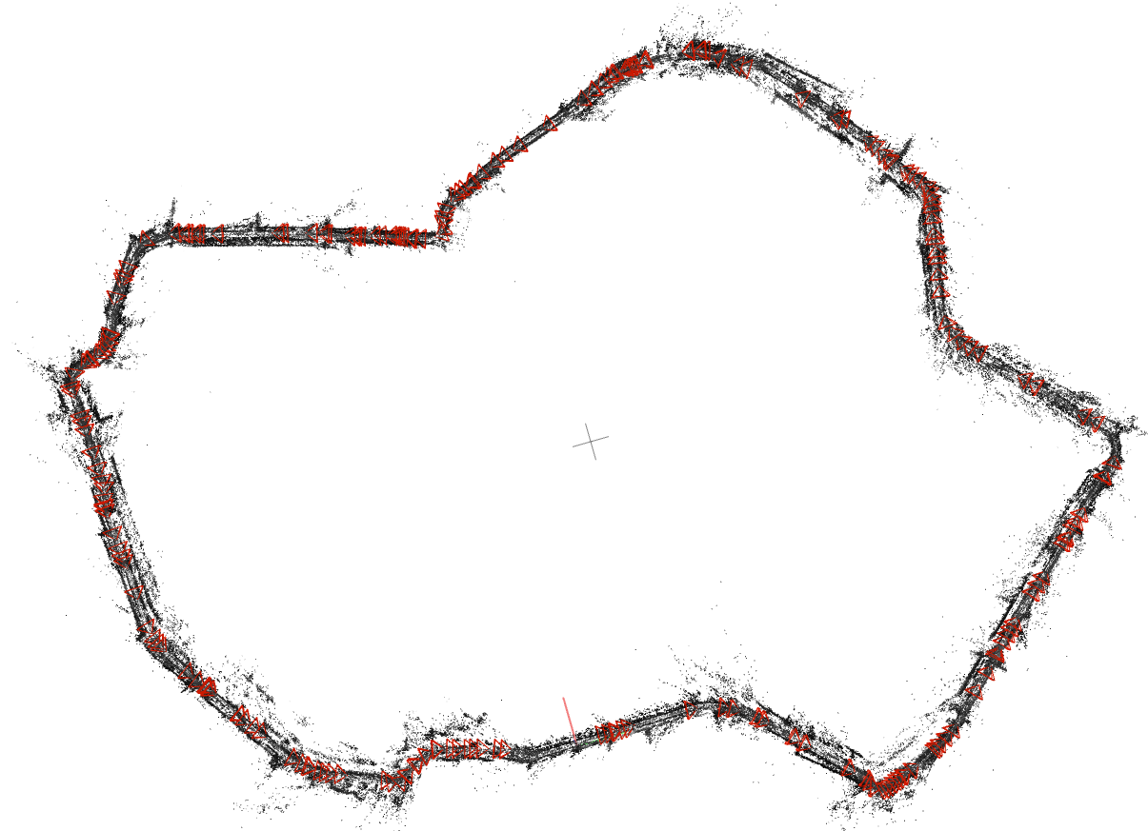
Results
Neighborhood
Oldtown

Slide 10
Summary and outlook
Advantages:
Use simple localization pipeline and SLAM
Use SLAM to improve image retrieval and sequential localization
Limitations:
Low efficiency of the localization algorithm
Localization cannot run online
Future work:
Solve limitations
Tightly couple SLAM and visual localization
Integrate more sensors

Slide 11
Thank you
yangyuchen@oppo.com

